Slide 1
See the full questions on the attached worksheets.

Slide 3
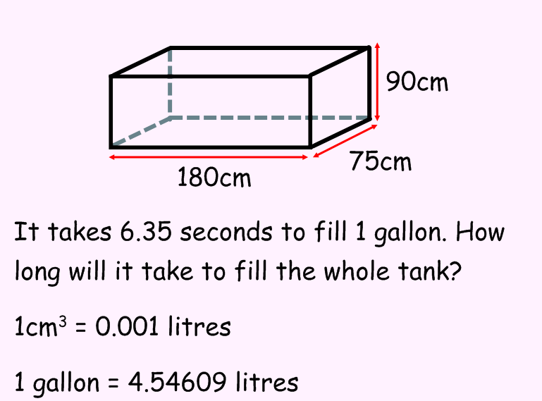

Slide 12
